Slide 1
E2E IMPLEMENTATION OF DATABRICKS INFRASTRUCUTRE

Slide 2
Problem we are solving
Before this – Everything was manual
No consistency between environment
No version control for infrastructure
Solution:
We describe every Azure and Databricks resources in terraform files, store them in github and deploy it automatically via github action. The platform can be created with less time and easy to set up identical environments.

Slide 3
Tools used:
Azure Portal
Databricks (azure workspace)
GitHub
VS Code (Install terraform, AZ Cli, Databricks Cli)
Resources created via terraform
Service Principle created in Microsoft Entra for authentication and role assignments are added for the sp(Contributor and User Access Administrator)
GitHub - Hosts the repository and runs pipeline using github actions.

Slide 4
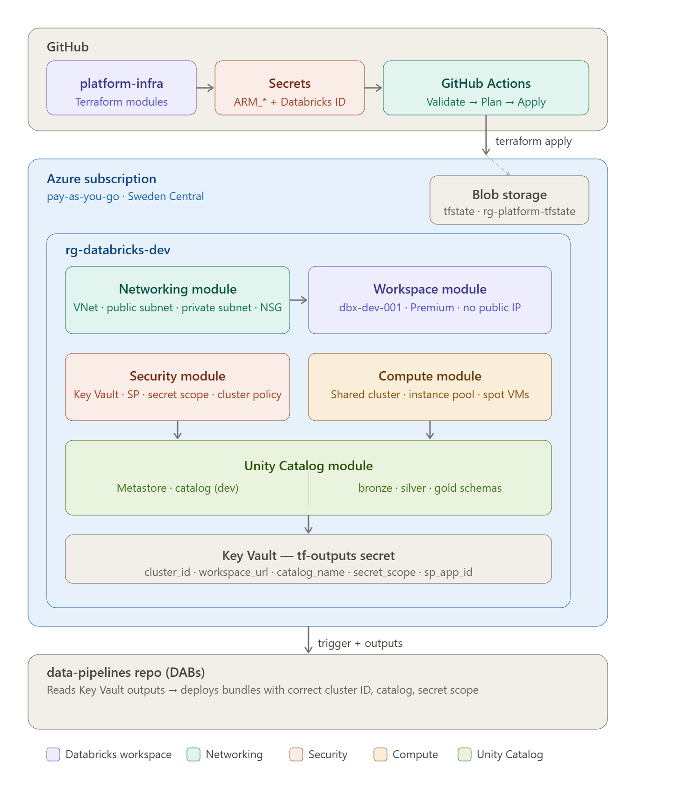
Architecture
Layer 1 - platform-infra (Terraform)
This repo creates the Azure and Databricks infrastructure - the workspace, virtual network, Unity Catalog, Key Vault, shared cluster.
Layer 2 - data-pipelines (Databricks Asset Bundles)
This repo deploys ETL jobs, notebooks, and pipelines that run inside the workspace.
How they connect - Key Vault
After platform-infra deploys, it writes the workspace URL, cluster ID, and catalog name into Azure Key Vault.
The data-pipelines pipeline reads those values from Key Vault — no hardcoded values anywhere.

Slide 5
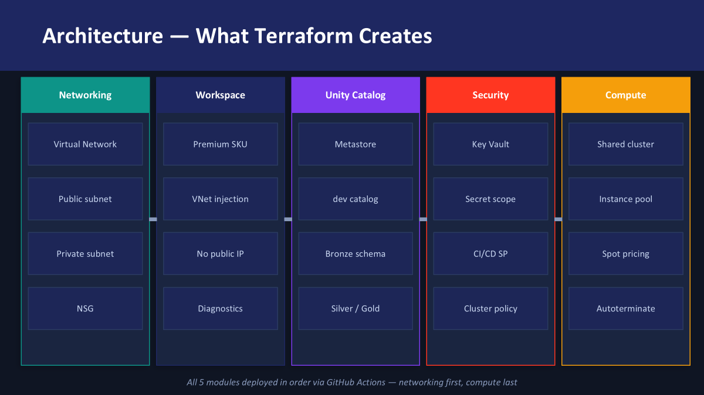

Slide 6
Platform-infra → what terraform modules creates
Networking module
Creates a Virtual Network with public and private subnets and a Network Security Group. Databricks clusters run inside this VNet — no public IP means cluster traffic stays private inside Azure. This is a security requirement.
Workspace module
Creates the Databricks workspace using Premium SKU and injects it into the VNet. Premium is required for Unity Catalog.
Unity Catalog module
Creates the metastore, the dev catalog, and three schemas — bronze, silver, and gold. This is the data governance layer.
Security module
Creates an Azure Key Vault to store secrets, a service principal for the CI/CD pipeline, a secret scope that links Databricks to Key Vault, and a cluster policy that limits what size clusters engineers can create — cost control.
Compute module
Creates a shared interactive cluster for ad-hoc queries and an instance pool that pre-warms virtual machines. Both use Azure spot pricing — up to 60% cheaper than on-demand. The cluster auto-terminates after 30 minutes idle.

Slide 7
Terraform Overview
Commands:
terraform init - initializes a working directory. It sets up the backend, installs required plugins, and prepares the env
terraform plan - generates an execution plan, showing the changes Terraform will make to achieve the desired state.
terraform apply - applies the changes defined in the configuration files to the infrastructure.
terraform destroy – deletes the resources.
Other commands : terraform fmt, terraform validate, terraform workspace
Typical Folder Structure:
Main.tf – what we are building
Variables.tf – input variables
Output.tf – what terraform returns
Providers.tf – where it’s being deployed eg, Azure, AWS…
Tfvars – Values are passed through .tfvars file.

Slide 8
Remote Backend
For storing terraform state files in Azure Blob Storage /AWS S3 Bucket
State locking – prevents concurrent operations
Enables versioning
Data encryption
Terraform state file(.tfstate)
To store information about the managed infrastructure
Keeps track of resources created and their current state
Allows terraform to understand what change needs to be made(create, upgrade, destroy)

Slide 9
Databricks Asset Bundles
A bundle is just a folder with your code + a YAML config file (databricks.yml) that describes everything your project needs:
Notebooks & Python files
Jobs and their schedules
Pipelines (Delta Live Tables)
ML models & experiments
Permissions and cluster configs
Commands used:
Databricks bundle validate
Databricks bundle deploy
Databricks bundle run
Databricks bundle destroy

Slide 10
databricks.yml is the blueprint for your Databricks job. It answers:
What is this bundle called?
Which notebooks run and in what order?
What cluster does it use?
Which catalog does it write to per environment?
deploy.yml is the automation that takes that blueprint and deploys it. It answers:
When should this pipeline run?
Which bundle should it deploy — customer, finance, or both?
How does it know the workspace URL? (reads from Key Vault)
Does it run the job after deploying?

Slide 11
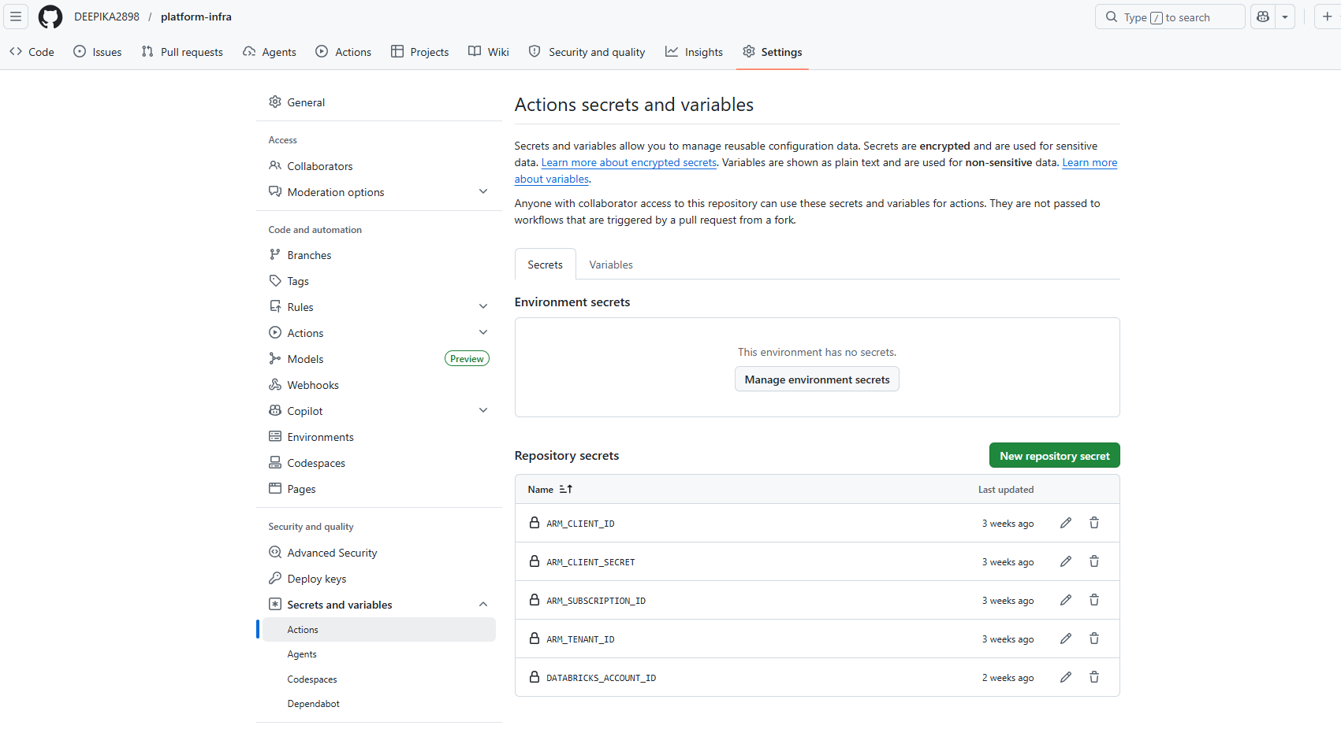

Slide 12
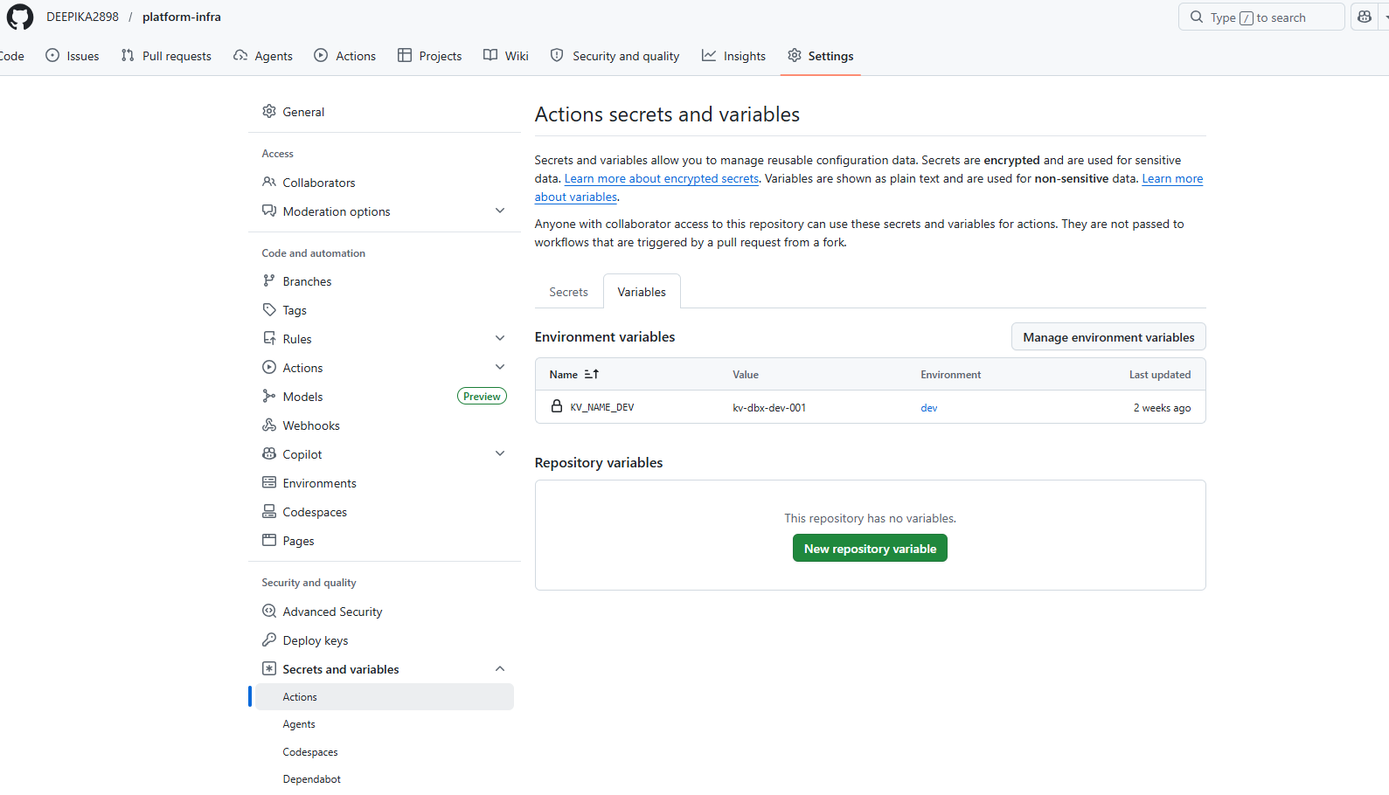

Slide 13
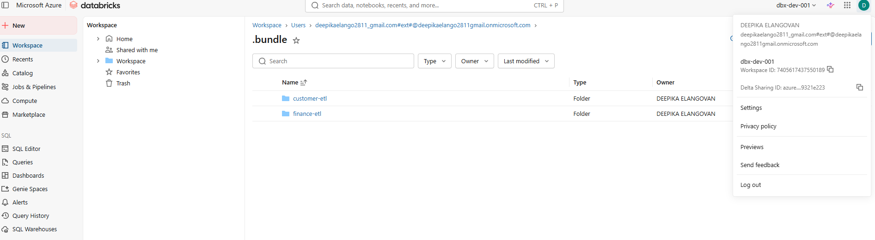
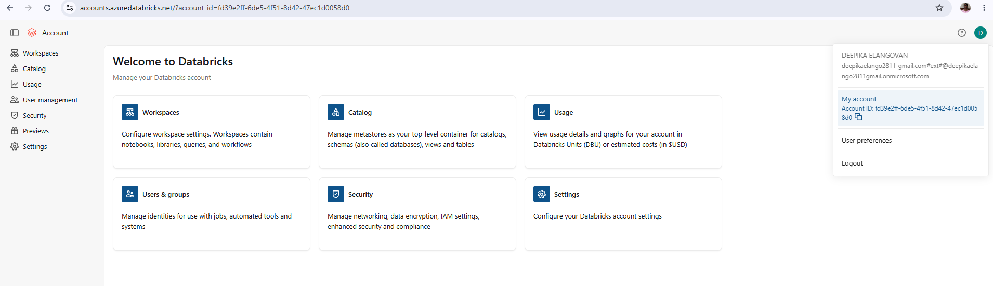

Slide 14
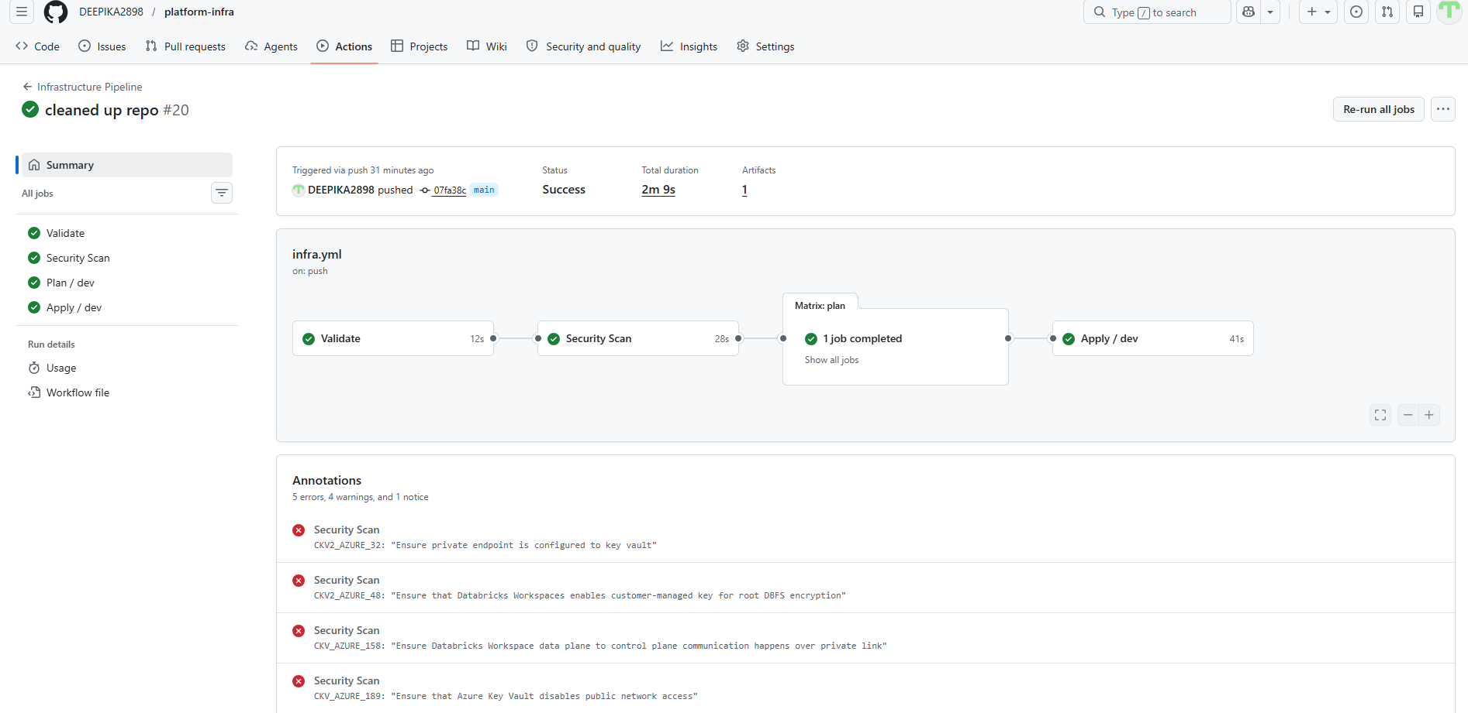

Slide 15
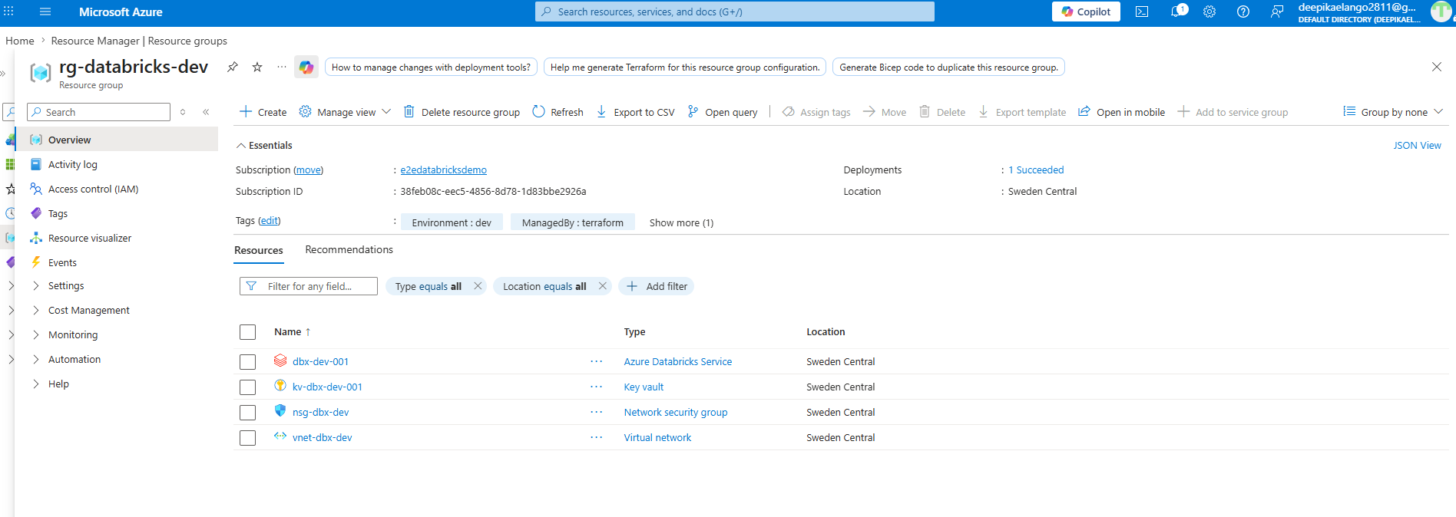

Slide 16
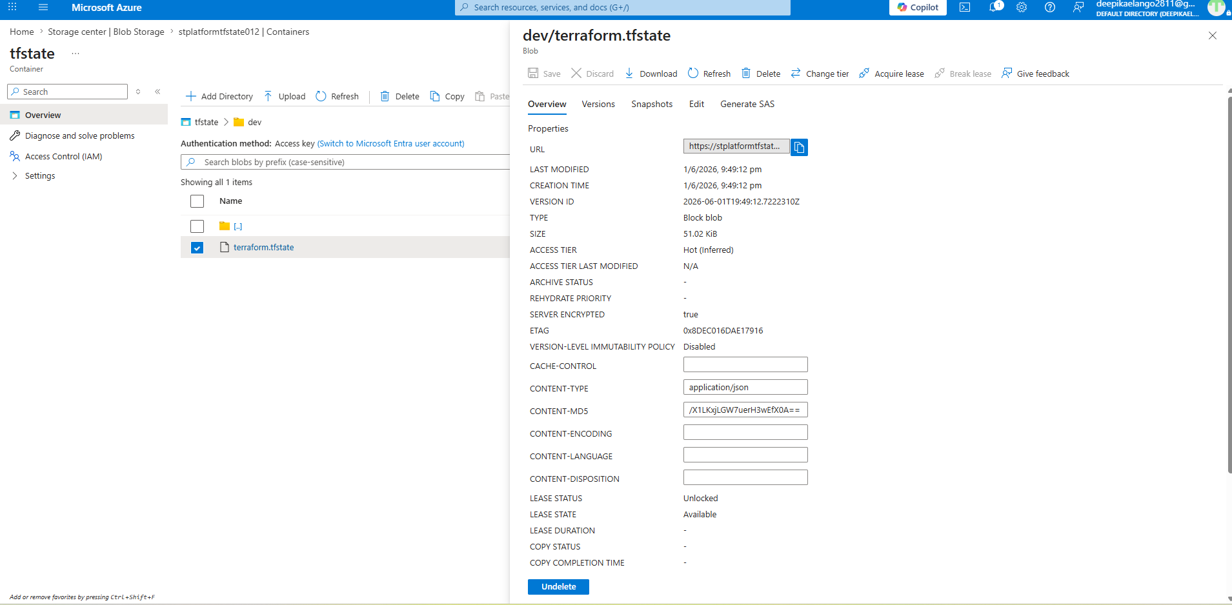
Remote Backend

Slide 17
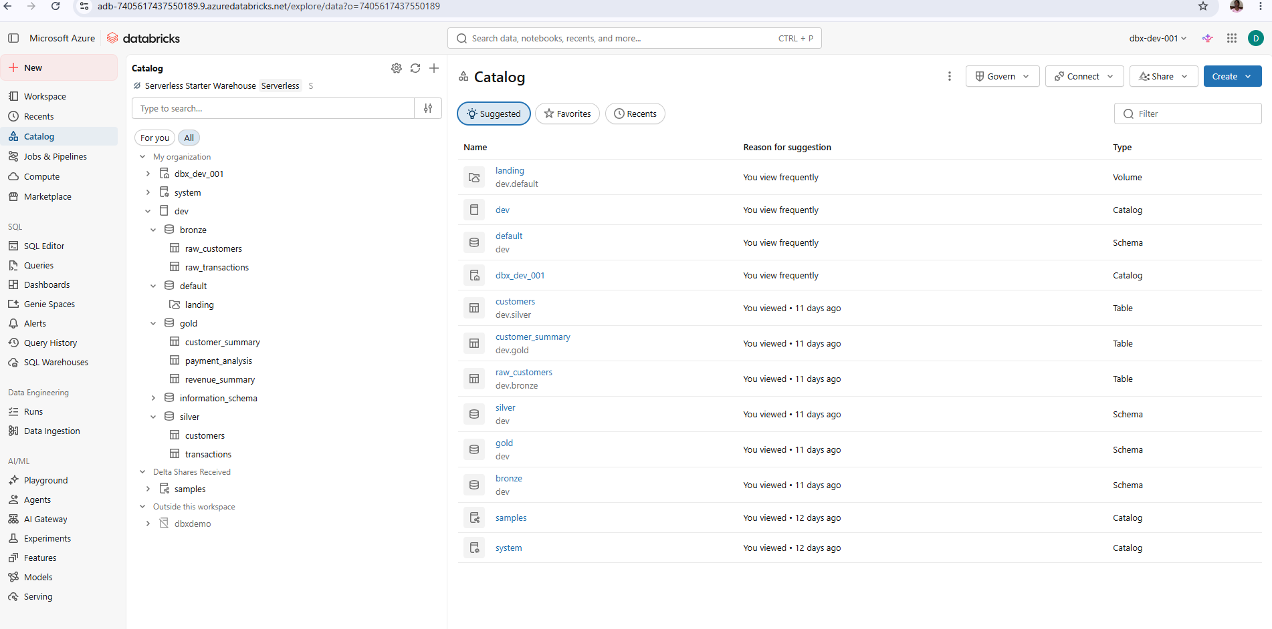
Catalog

Slide 18
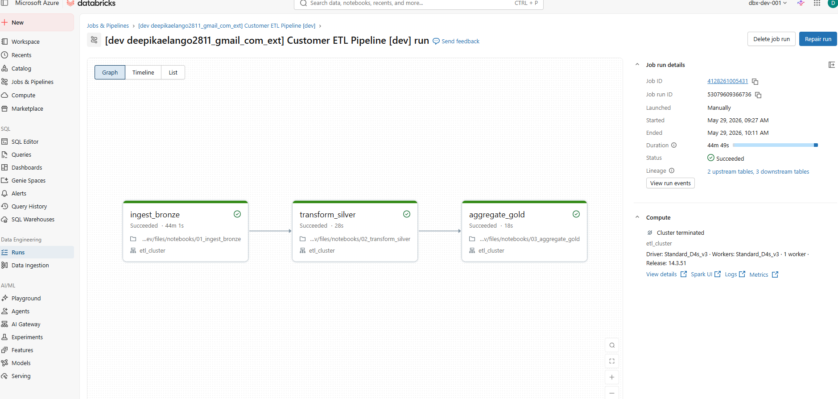

Slide 19
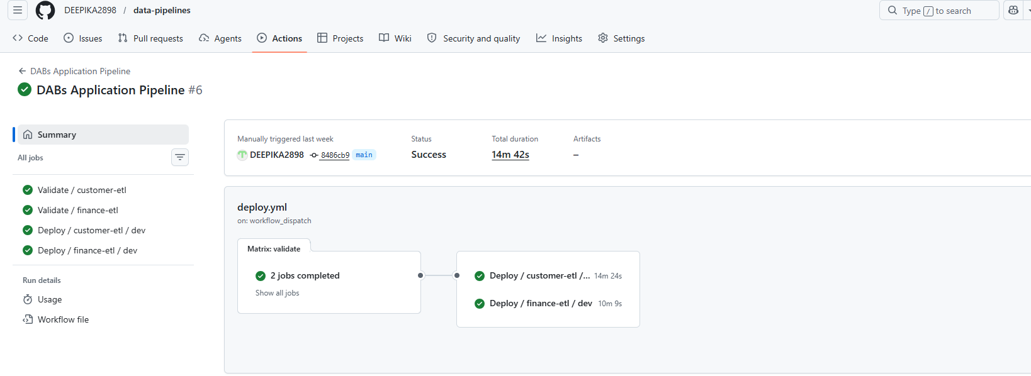

Slide 20
